Slide 1
ANALYSIS OF CRYPTOCURRENCY TRENDS USING SOCIAL SENTIMENT
Data Drivers (team members)
Nandhini Nagarathinam, Sai Preetham Reddy Leburu
Suhas Chikkanaravangala VijayaKumar, Aishwarya Kasturi
Notes:
hello

Slide 2
AGENDA
Problem Description
Data Exploration
Data Preprocessing and Representation
Learning Models Used
Model Performance and Results
Limitations and Future Work

Slide 3
PROBLEM DESCRIPTION
Can Twitter data be used to predict the prices of cryptocurrencies ?
The goal of this project is to find the relation between the Sentiment of the social media and market sentiment of the crypto currency using the machine learning algorithm.
Analyze if social sentiment has impact on crypto trends.

Slide 4
DATA EXPLORATION
Tweets are the Primary Data Source.
Collected top 40 tweets related to bitcoin and ethereum from Jan 2018 to June 2021.
Custom Tweet Scraper with help of selenium webdriver and beautiful soup libraries .
Custom Tweet Scraper fetches the tweets with
particular keyword
specific timeline
minimum number of likes, retweets, replies.

Slide 5
DATA PREPROCESSING & REPRESENTATION
Following fields were collected from scraping:
ID
Username
Tweet
Likes
Retweets
Replies
Time

Slide 6
DATA PREPROCESSING & REPRESENTATION
Dropped neutral tweets.
Removed irrelevant columns and replaced them with null values.
Converted the cases into lower cases in tweets.
Removed the hashtags from the tweets.
Removed the stopwords.
Tokenization is done for the words.

Slide 7
DATA PREPROCESSING & REPRESENTATION
Collected a list of frequently positive, frequently negative, positive and negative words to assess the tweet.
Sentiment of Tweets will divided into positive or negative based on the emotional score.
Emotional Score will be calculated based on following:
Positivity/Negativity in a tweet.
Number of likes, retweets and replies

Slide 8
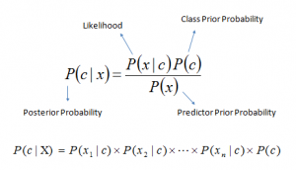
LEARNING MODELS USED
Used Multinomial Naive Bayes Classifier for our model.
Vectorizing the features data before passing to the classifier
Formula : -

Slide 9

BAG OF WORDS MODEL
BOW model is used for feature extraction in text data
Returns a word with all the words and the number of times each word is repeated.
The document term matrix can be generated using sklearn’s CountVectorizer module.

Slide 10
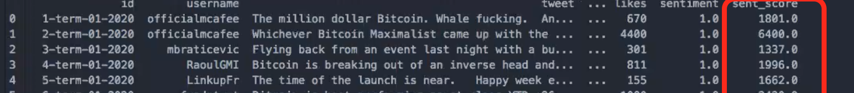
SENTIMENT SCORE
Since we have only two output classes, the model classifies the given new instance of tweet as either as positive or negative.
Formula for the Sentiment Score
sent_score = sentiment * 1000 + (number of retweets + number of likes)
Sentiment = 1 if positive
-1 if negative
The average market price and sentiment score is calculated for each month for the year 2020

Slide 11
EXAMPLES
Classified as Positive:
“ Bitcoin is best performing asset class YTD +26%... demand for "safe haven" is boosting Bitcoin and arguably, #Bitcoin is seen as a better "safe haven" than $Gold #gold - Gold is up a decent 3% vs a whopping 26% for Bitcoin ”
Classified as Negative :
“Bitcoin never stays in the TEAL BUY ZONE for long! ”

Slide 12
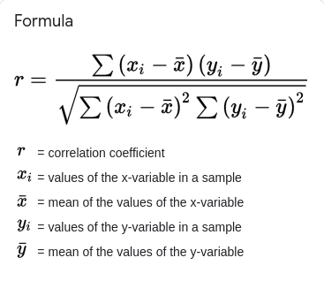
CORRELATION
Pearson correlation coefficient
X_{i} = Sentiment Score for the month i
Y_{i} = Market Price for the month i
correlation coefficient(r) =
Bitcoin : 0.735
Ethereum: 0.470

Slide 13
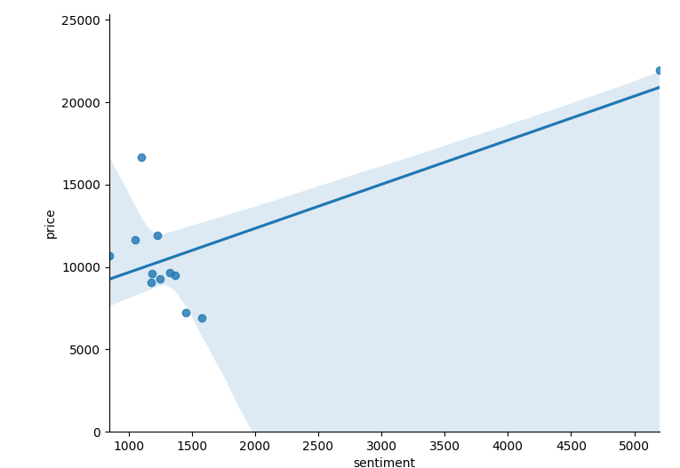
LINEAR REGRESSION - BITCOIN

Slide 14
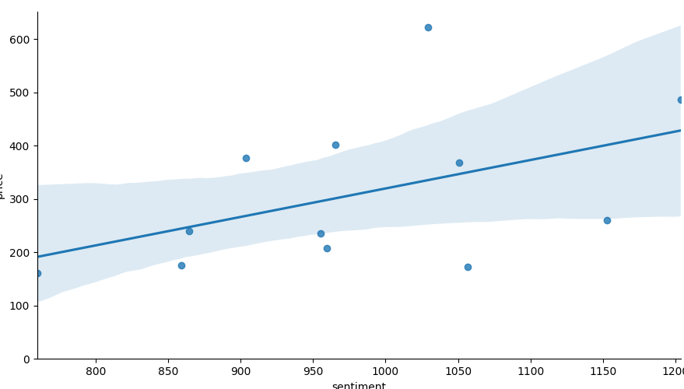
LINEAR REGRESSION - ETHEREUM

Slide 15
MODEL PERFORMANCE AND RESULTS
Our Model has an accuracy of 93.94%.
Results of sentiment analysis and market sentiment have been represented on monthly basis.
Results are illustrated in graphs with Months as X-axis and sentiment score as Y-axis.
Model utilizes cryptocurrencies of bitcoin and ethereum
Social sentiment analysis results shows that bitcoin prices are highly influenced by Twitter posts rather than the Ethereum.

Slide 16
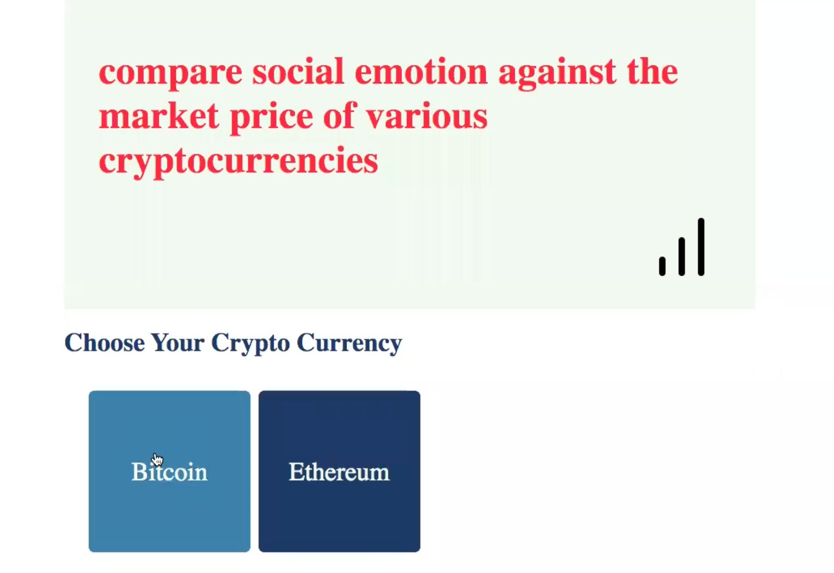
WEB APPLICATION
Developed web application for visualization of output with user interaction.
Technologies used :
Frontend : HTML, CSS, JavaScript, Chart.js
Backend: Python
Frameworks used: Flask
provides tools and libraries to help build web apps quite easily by taking care of tasks like hosting, routing

Slide 17
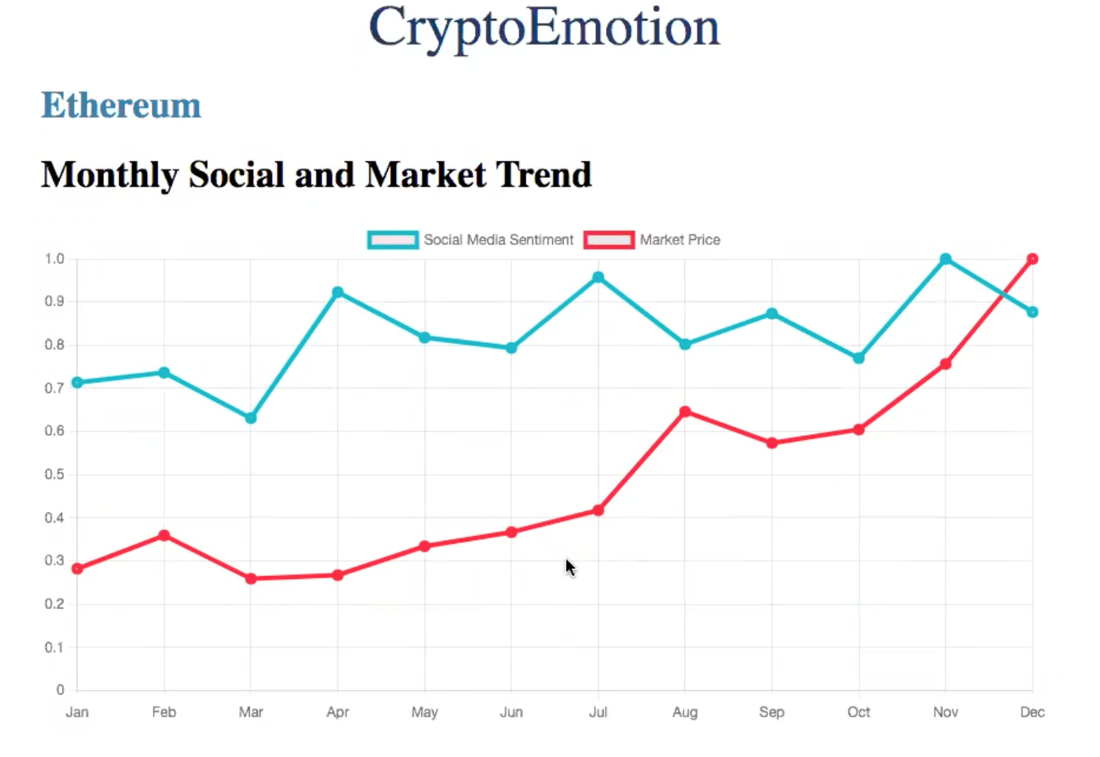
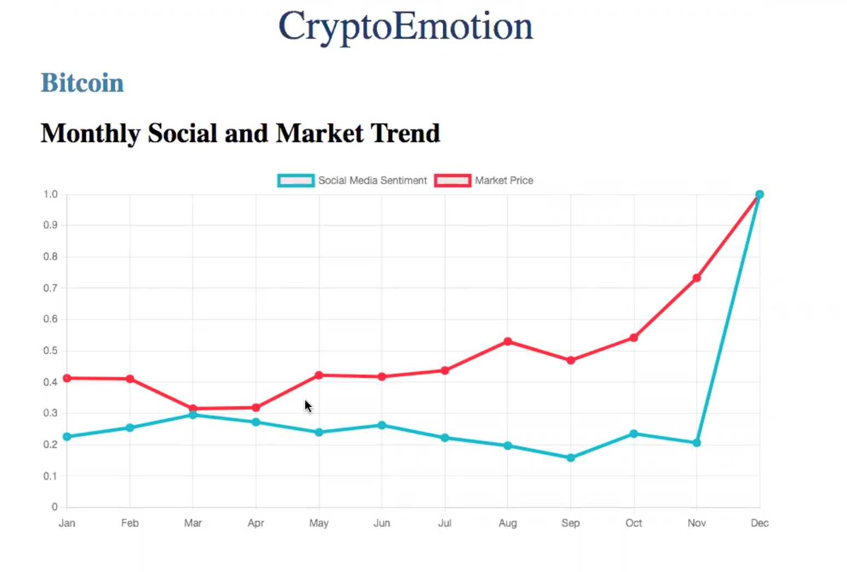
DATA VISUALIZATION

Slide 18
LIMITATIONS AND CHALLENGES
FUTURE ENHANCEMENTS
This model is not just limited to crypto and can further be used as a generic system for analyzing sentiments for a wide range of domains.
By collecting sufficient number of tweets for each week, the correlation between tweet sentiment and market price can be viewed on a weekly basis.
The most challenging part of this project would be dealing with complex sentences that require more than sentiment words and simple analyzing
The sentiment analysis performed here was very simple. The very presence of a negative or positive word does not mean the tweet is positive or negative(i.e sarcasm)
Insufficient tweets.

Slide 19
CONCLUSION
Using machine learning for studying market trends is the next huge breakthrough as it is a very time-consuming form of analysis for an investor to keep with the market trends on a daily basis.
The vision of this application is to make crypto trading simpler and reliable and provide traders with relevant insights to make smart investment decisions.

Slide 20


Slide 21



